Slide 1



Workshop on
AGRO-RESIDUES AT THE CROSSROAD TOWARDS 2030
Brussels, European Parliament, 17 May 2018
EUROPEAN PARLIAMENT
Take-off for sustainable supply of woody biomass
from agrarian pruning and plantation removal
Prof. Massimo Monteleone
University of Foggia, Italy
This project has received funding from the European Union’s Horizon 2020 research and innovation programme.
Grant Agreement No 691748
EUROPEAN COMMISSION
Innovation and Networks Executive Agency
ENERGY RESEARCH
Disclaimer: this document reflects the author’s view only, and INEA is not responsible for any use that may be made of the information it contains

Slide 2

EU Climate and Energy Roadmap
2
GHG reduction over time
The European Union (EU) is on track to achieve its GHG emission reduction target of a 20 % decrease.
Faster rates of GHG emission decreases are necessary to achieve an 80 %, or even a 95 %, decrease by 2050.
GHG emissions in 1990 = 5.4 Ttoe
Share of renewables over time
The European Union (EU) is currently on track to meet its renewable energy target, i.e. that 20 % of its energy should come from renewable sources by 2020.
In view of the EU’s longer-term target for 2050, the RES deployment rate should increase significantly.
European Parliament – Agro-residues at the crossroads towards 2030 – Brussels, 17 May 2018

Slide 3
EU Climate and Energy Roadmap
3
An exceptional effort needs to be deployed in order to boost transition towards renewable energies, on both supply and demand side
This requires a strong and rapid strengthening of the renewable energy installed capacity
At the same time, considerable efforts must be made to improve energy conversion efficiency as well as energy end-use efficiency
01
Key message
European Parliament – Agro-residues at the crossroads towards 2030 – Brussels, 17 May 2018

Slide 4
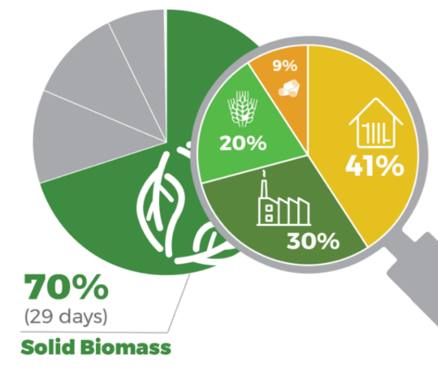
Bioenergy and Solid Biomass
4
Bioenergy is by far the most significant renewable energy source in the EU. It accounts for 64 % of all renewable energy production in 2016
More than two thirds of biomass consumed in Europe consists of solid biomass being mostly forestry residues and to a limited extent agricultural by-products
EU-28 gross inland energy consumption of solid biomass
European Parliament – Agro-residues at the crossroads towards 2030 – Brussels, 17 May 2018

Slide 5
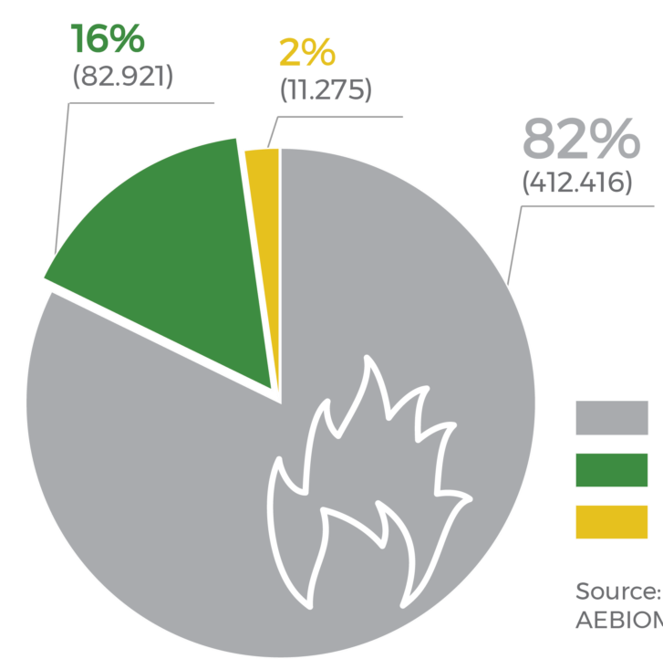
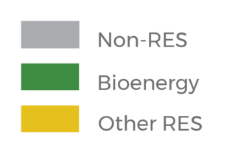
Bioenergy and Solid Biomass
5
Heating and cooling represents around 50% of total EU energy consumption, of which 82% is powered by fossil fuels
Bioenergy is currently the leading renewable in heating and cooling (88%) representing 16% of European gross final consumption of energy in this sector
Renewables are becoming a key priority for EU policy, specifically in buildings, a sector which is essential to address in order to reach EU decarbonisation objectives
EU-28 share of energy in the gross final energy consumption for heating & cooling
European Parliament – Agro-residues at the crossroads towards 2030 – Brussels, 17 May 2018

Slide 6
Bioenergy and Solid Biomass
6
The contribution of bioenergy to a low-carbon scenario is of crucial importance
Sustainable bioenergy is an essential element in the portfolio of measures for a low-carbon energy system also in the years to come
Energy from solid biomass is a strategic asset in EU
The heating and cooling sector remains underestimated, showing great room for improvement
02
Key message
European Parliament – Agro-residues at the crossroads towards 2030 – Brussels, 17 May 2018

Slide 7
Potential of the Pruning Energy Sector in Europe
7
Fruit tree cultivation area = 11.33 kha
Potential pruning availability = 25 Mt/y
Potential power generation = 23.9 TWh/y
  (= 3 GW installing capacity; = 4.9 Billion €; = 15 Million of people)
Potential heat generation = 57.9 TWh/y
  (= 7 GW installing capacity; = 3.6 Billion €)
European Parliament – Agro-residues at the crossroads towards 2030 – Brussels, 17 May 2018
Notes:
Plantations with soft fruit, citrus, olives but also vineyards can cover quite a significant surface. In order to estimate the residue potential the permanent cropping areas derived from Eurostat 2015 were combined with average harvest ratios per type of permanent crop. The harvest ratios were derived from several publications.

Slide 8
Potential of the Pruning Energy Sector in Europe
8
Agro-residues (and particularly pruning) are a relevant renewable energy source, but still not used or largely under-used
The energy (heat & electricity) that can be obtained by mobilizing pruning residues in EU is potentially impressive and should be sustainably tapped
03
Key message
European Parliament – Agro-residues at the crossroads towards 2030 – Brussels, 17 May 2018

Slide 9
Climate Friendly Energy Value Chains
9
How much GHG emissions are potentially saved ?
Energy value chains based on pruning reach a 90 % of GHG savings as compared with fossils (by LCA calculations)
23.9 TWh of electricity are theoretically able to substitute approximately 8.4 Mt of CO₂ equivalent (considering CCGT generation)
How much CO2 is theoretically sequestered ?
This overall amount of CO₂ emission saved approximately corresponds to 560 kha of new forested area

Slide 10

Climate Friendly Energy Value Chains
10
Agro-residues (and particularly pruning) can contribute to replace or minimize the consumption of fossil fuels and to reduce the emissions of GHGs responsible for global climate change
The carbon footprint of agro-pruning energy value chains is very low and GHG savings as compared to fossils are very high
04
Key message
European Parliament – Agro-residues at the crossroads towards 2030 – Brussels, 17 May 2018

Slide 11
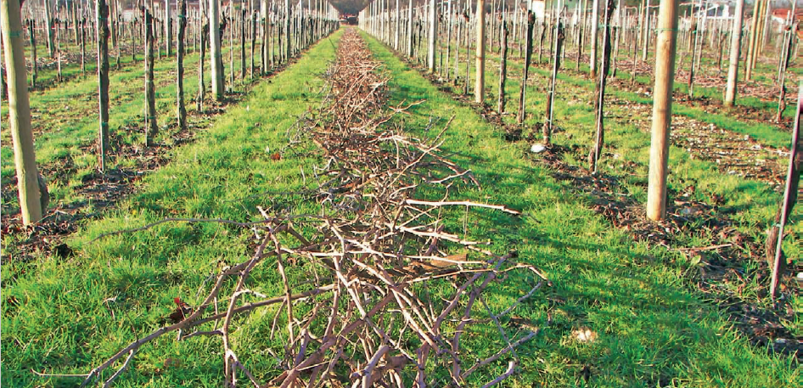
Pruning does not Compete with Food Crops
11
European Parliament – Agro-residues at the crossroads towards 2030 – Brussels, 17 May 2018

Slide 12
Pruning does not Compete with Food Crops
12
Since pruning is a residual kind of biomass (i.e. not obtained as main product, bu as by-product) its use as energy carrier does not threaten food production, nor it subtracts agricultural land from ordinary food crops
It represents a totally new, supplemental and complementary energy source
05
Key message
European Parliament – Agro-residues at the crossroads towards 2030 – Brussels, 17 May 2018

Slide 13
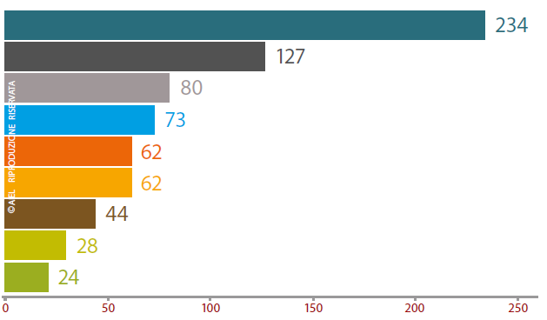
Solid Biomass is Cost Competitive
13
Comparison of primary energy costs (€/MWh) produced by fossil fuels and solid biomass energy carriers
LPG (Liquid Propane Gas)
Heating oil
Heating oil for agriculture
Methane for households
Pellet in bags (15 kg) Enplus A1
Pellet in tank-trucks Enplus A1
Wood log M20
Wood chip A2 (M35)
Wood chip B (M50)
Data source: AIEL
European Parliament – Agro-residues at the crossroads towards 2030 – Brussels, 17 May 2018

Slide 14
Solid Biomass is Cost Competitive
14
Wood biomass is one of the most profitable energy carrier and solid biofuels to be implemented in heating appliances, household boilers, district heating systems, etc.
Agro-residues are generally lower in heating quality than solid biomass from forestry, but very cost competitive
06
Key message
European Parliament – Agro-residues at the crossroads towards 2030 – Brussels, 17 May 2018

Slide 15

A Flywheel for Rural Development
15
Bioenergy value chains are connected and included within the territorial milieu, offering new opportunities and services, in a complementary relationship with pre-existing agricultural activities. A large variety of bioenergy value chains and business models are available, each according to specific territorial characteristics. Bioenergy creates jobs in the region.
European Parliament – Agro-residues at the crossroads towards 2030 – Brussels, 17 May 2018

Slide 16
A Flywheel for Rural Development
16
Promote new forms of agro-industrial integration and lessens the energy dependence of the agricultural sector
Agro-residues promote rural development; being rooted at local scale, is a community oriented, self-reliance, self-sustaining models of development
According to a multifunctional strategy, bioenergy enhance the farm productive diversification and favour income integration
07
Key message
European Parliament – Agro-residues at the crossroads towards 2030 – Brussels, 17 May 2018

Slide 17
Policy Recommendations
17
Setting ambitious bioenergy targets
Fostering biomass mobilization and securing its supply
Favoring profitable and stable investments in the bioenergy sector
Simplifying and harmonizing administrative procedures
Promoting an intelligent and flexible financial support
Supporting industrial leadership and technological development
Phasing out from fossil subsidies through Carbon pricing
Targeting effective technologies, value chains and business models
Solid fuel quality standards, fuel flexibility, eco-design and retrofitting technologies

Slide 18
Thank you very much for your attention!
www.up-running.eu
Massimo Monteleone
University of Foggia (IT)
Email: massimo.monteleone@unifg.it
Project Coordinator
Daniel Garcia Galindo
CIRCE Fundation
Email: Daniel.Garcia@fcirce.es

